Slide 1

BASIC STATISTICS

Slide 2
STATISTICS
POPULATION AND SAMPLE
VARIABLES: QUALITATIVE & QUANTITATIVE
DESCRIPTIVE & INFERENTIAL
DESCRIPTIVE
INFERENTIAL

Slide 3

POPULATION AND SAMPLE
A population is any specific collection of objects of interest.
A sample is any subset or subcollection of the population.
SAMPLING → BIASES!!!!!!!

Slide 4

VARIABLES: QUALITATIVE & QUANTITATIVE
Qualitative data are measurements for which there is no natural numerical scale, but which consist of attributes, labels, or other non-numerical characteristics.
Quantitative data are numerical measurements that arise from a natural numerical scale → DISCRETE AND CONTINUOUS
SOMETIMES QUANTIFICATION IS NEEDED

Slide 5

DESCRIPTIVE & INFERENTIAL
Descriptive statistics is the branch of statistics that involves organizing, displaying, and describing data.
Inferential statistics is the branch of statistics that involves drawing conclusions about a population based on information contained in a sample taken from that population.

Slide 6

DESCRIPTIVE
Central tendency: Mean, Median and Mode.
Variability: Range (Max-Min), Variance (Standard Deviation), Kurtosis, etc.

Slide 7

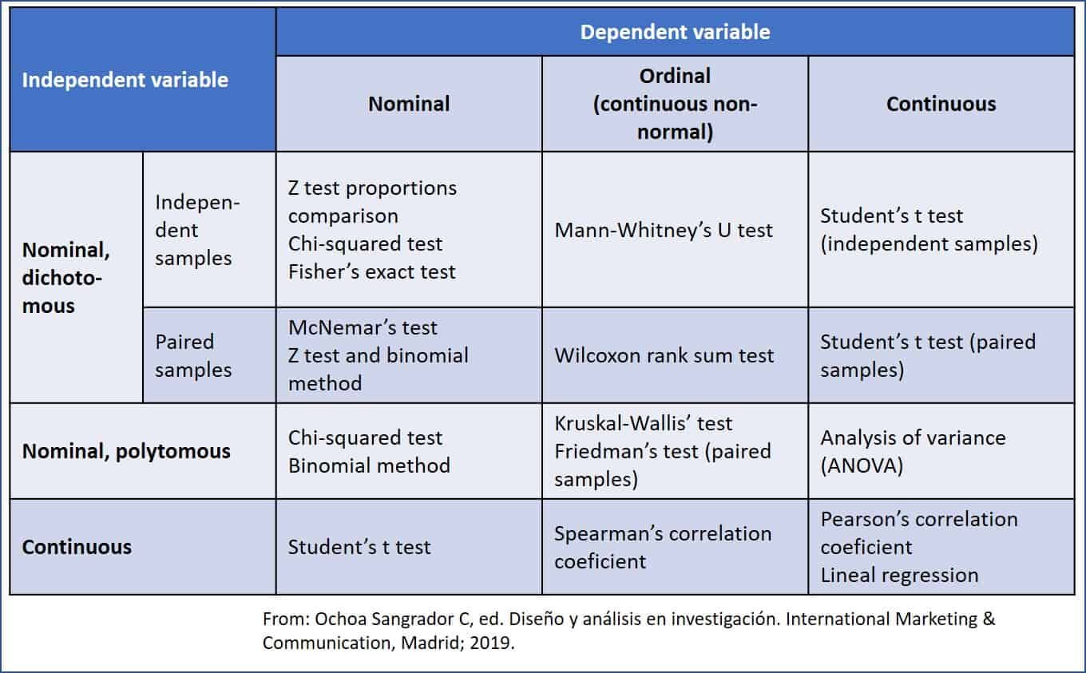
INFERENTIAL
Parametric: distribution is known
Non-parametric: no assumptions

Slide 8


Slide 9
thanks

